Slide 1
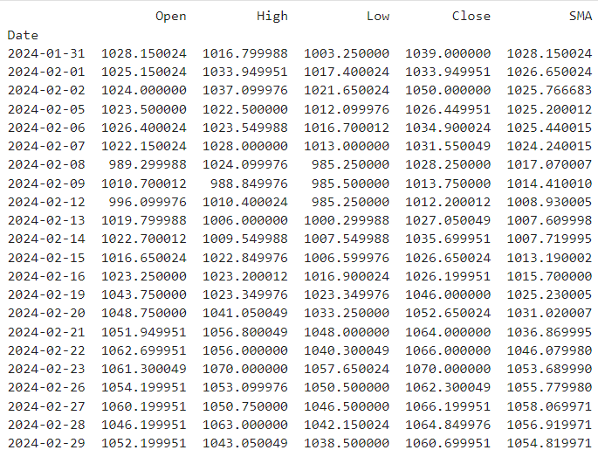
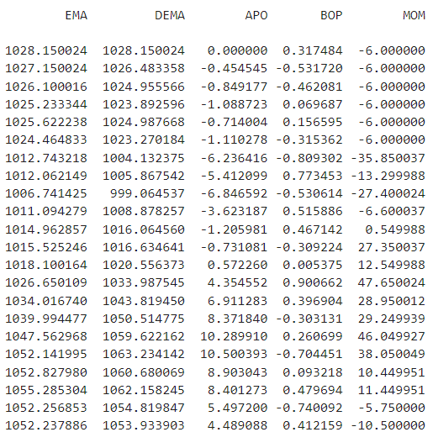
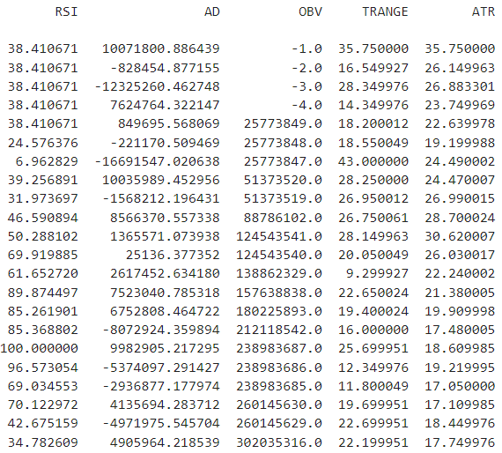

Slide 2
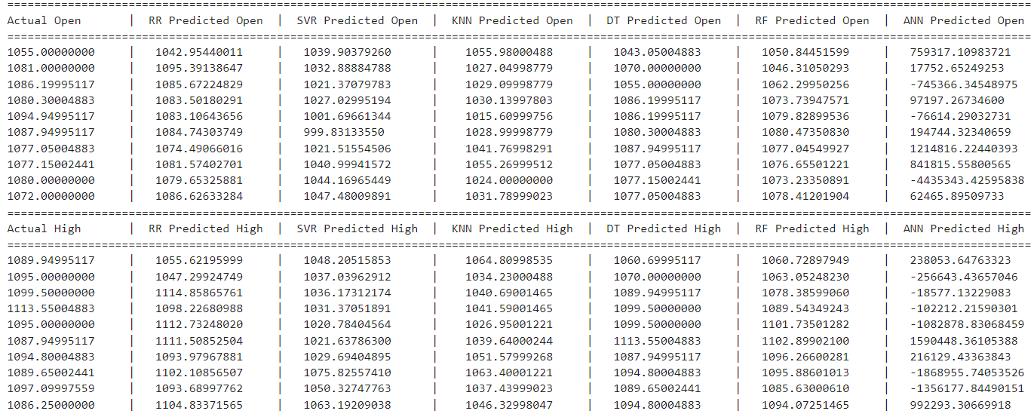
COMPARED ACTUAL AND PREDICTED PRICES
OPEN
HIGH

Slide 3
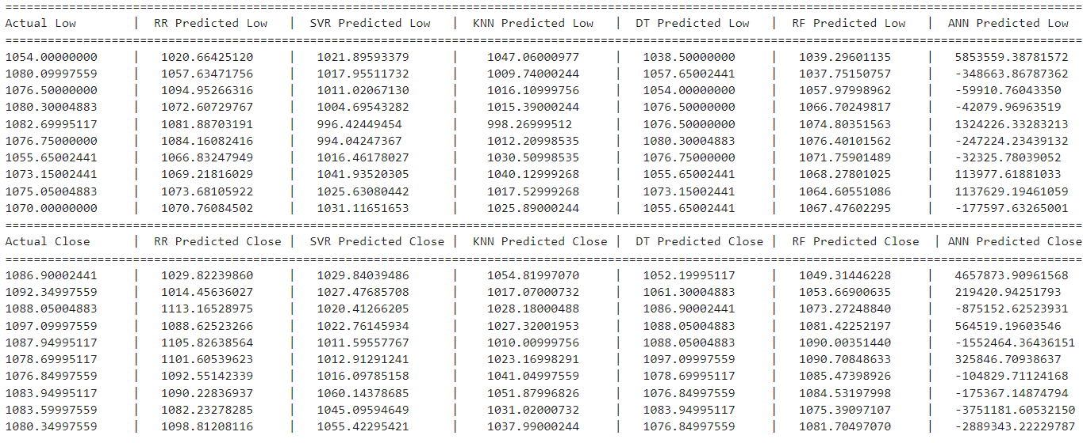
COMPARED ACTUAL AND PREDICTED PRICES
LOW
CLOSE

Slide 4
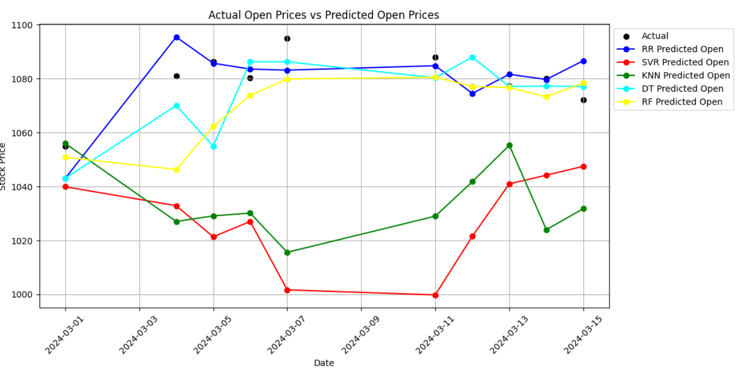
OPEN PRICE

Slide 5
HIGH PRICES

Slide 6
LOW PRICES

Slide 7
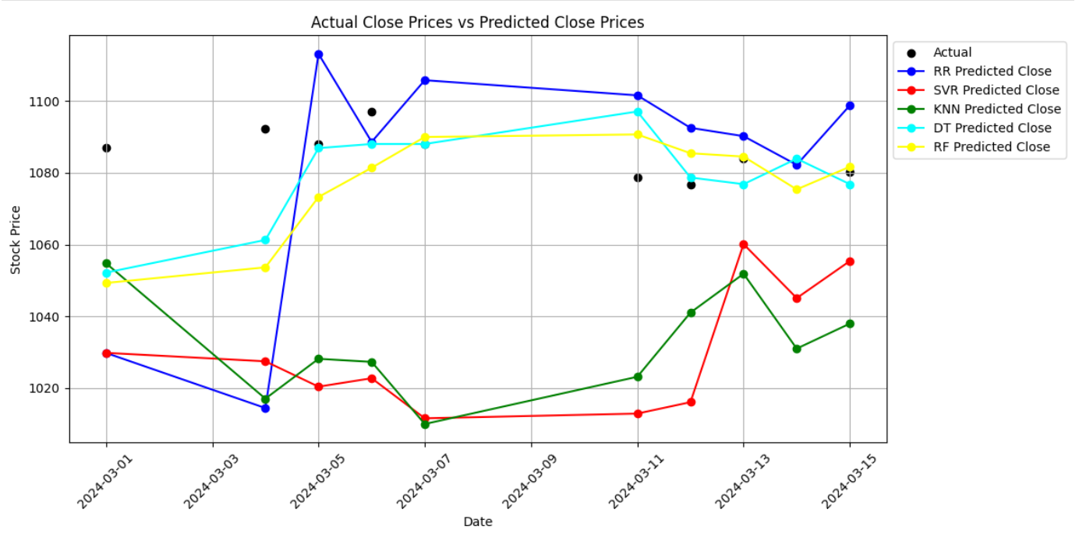
CLOSE PRICES

